Slide 1
How do the RBMs work?
Krzysztof Kolasiński March - 2017

Slide 2
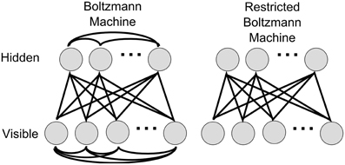
What is RBM
It is a Boltzmann machine with restriction
latent space
This restriction leads to significant simplification of the model
for example pixels of image

Slide 3
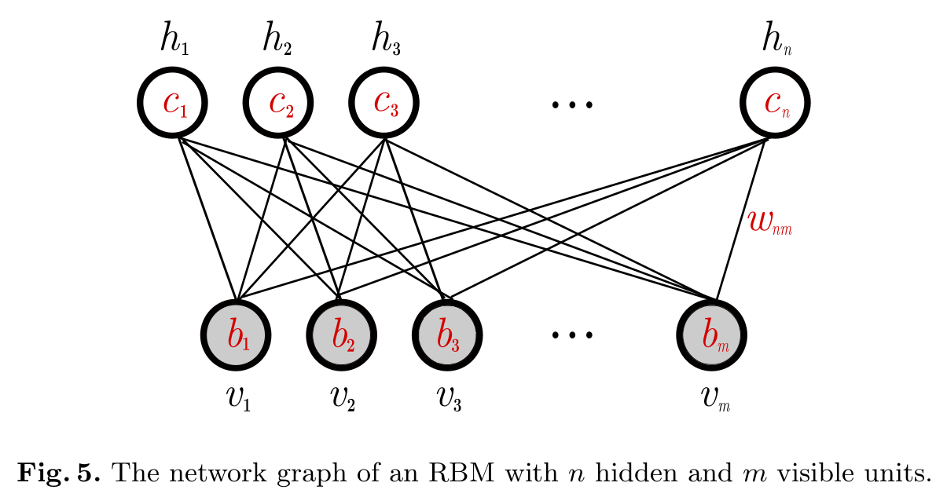
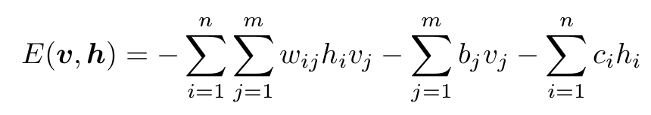
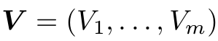
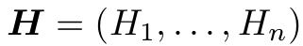

What is RBM
RBMs are defined in term of energy function
represent the observable data
to capture the dependencies between observed variables
W is a matrix which connects the visible and hidden units
b, c are the bias terms associated with visible and hidden units

Slide 4
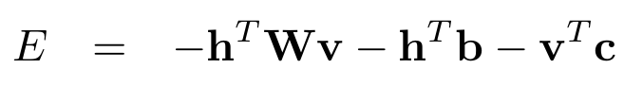
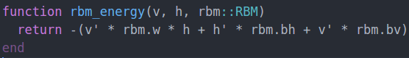
What is RBM
RBMs are defined in term of energy function
For a given configuration of units V and H we can compute energy as:

Slide 5
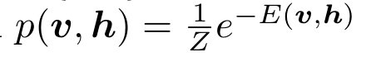
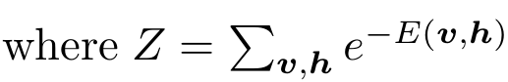
What is RBM
RBMs are defined in term of energy function
For a given configuration of units V and H we can compute energy as:
Each configuration of using has defined probability (Boltzmann distribution)
is a partition function

Slide 6
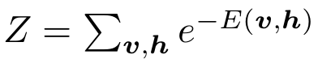
On partition function
It contains sum of all possible hidden/visible configurations
Let us consider the case where V = {v₁, v₂, v₃} and H = {h₁, h₂}.
For V we have 2³ possible configurations: {0,0,0}, {0,0,1}, {0,1,0}, {0,1,1}, {1,0,0}, {1,0,1}, {1,1,0}, {1,1,1}
For H we have 2² possible configurations: {0,0}, {0,1}, {1,0}, {1,1}
In real world examples the Z is intractable, for example MNIST images has dimensions of 28x28 pixels. This gives 2^{28x28} possible configurations.

Slide 7
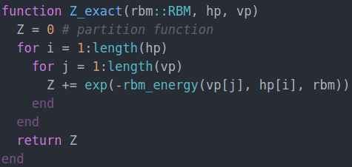
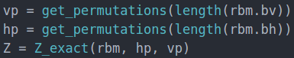
On partition function
It contains sum of all possible hidden/visible configurations
Let us consider the case where V = {v₁, v₂, v₃} and H = {h₁, h₂}.
For V we have 2³ possible configurations: {0,0,0}, {0,0,1}, {0,1,0}, {0,1,1}, {1,0,0}, {1,0,1}, {1,1,0}, {1,1,1}
For H we have 2² possible configurations: {0,0}, {0,1}, {1,0}, {1,1}
In the example above the sum can be computed easily:

Slide 8
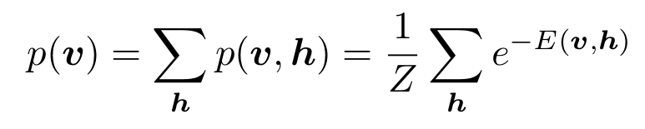
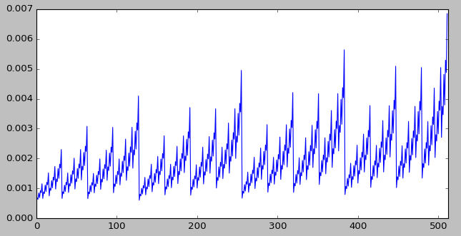
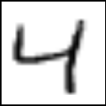


What do we want to maximize?
The RBM:
We want to find W, b, c such that the probability of observing V will be maximal
marginal distribution of V
Example of the concept: high probabilities for pictures similar as in data set

Slide 9
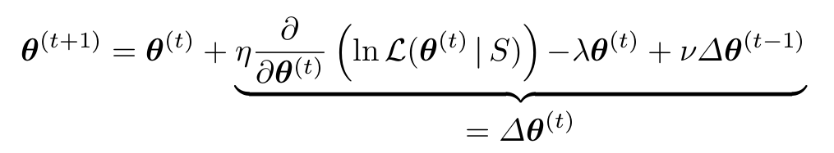
What do we want to maximize?
The RBM:
We want to find W, b, c such that the probability of observing V will be maximal
We look for optimal (W, b, c) = theta using standard gradient ascent on log-likelihood
Regularization + momentum

Slide 10
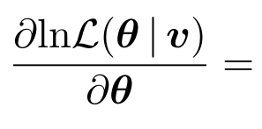
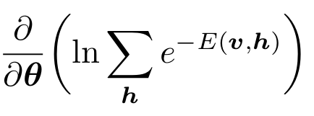
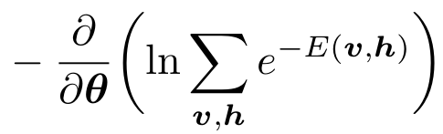
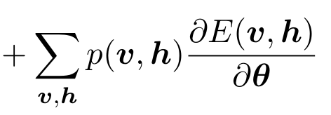
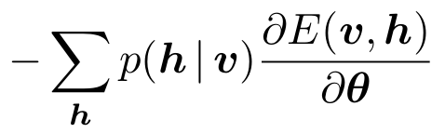
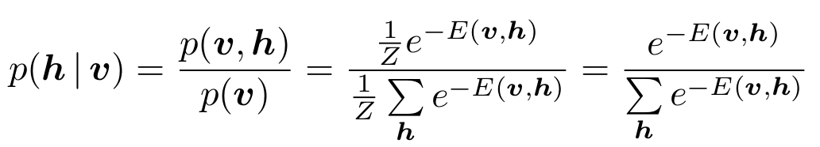
Expression for gradients
We are looking for expression of gradient of L with respect to model parameters (theta)
It’s a simple math:
=
This is still intractable

Slide 11
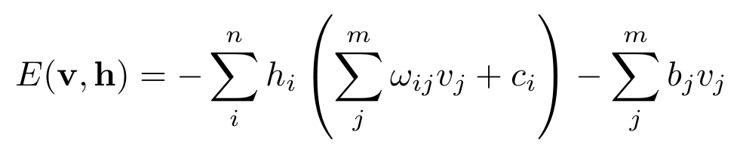
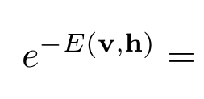
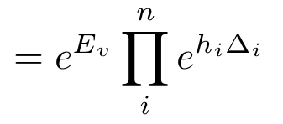
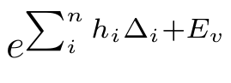
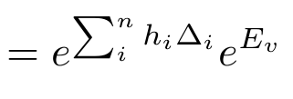
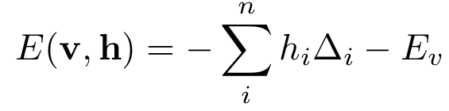
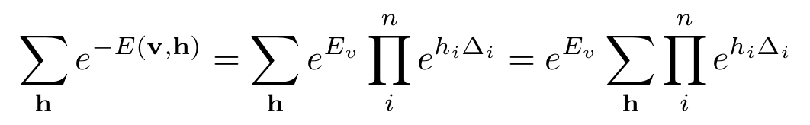
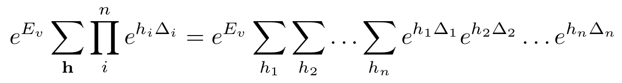
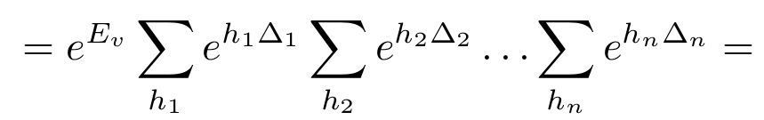
Finding expression for p(h| v)
Due to the structure of RBMs the conditional probability p(h| v) can be found analytically
Let’s group E by h_{i}
Let’s write it explicitly

Slide 12
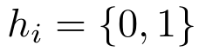
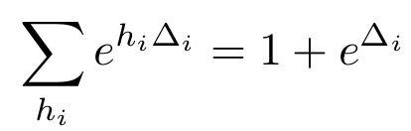
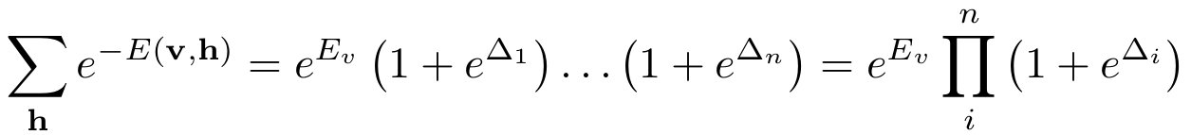
Finding expression for p(h| v)
Due to the structure of RBMs the conditional probability p(h| v) can be found analytically
Let’s group E by h_{i}
Let’s write it explicitly
h_{i} is a binary variable:
This gives

Slide 13
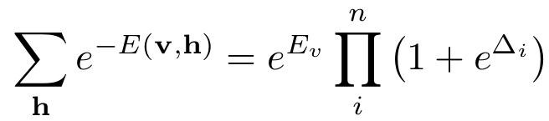
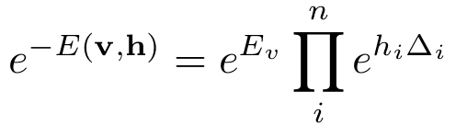
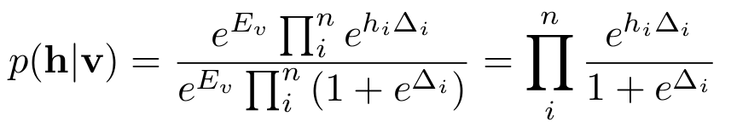
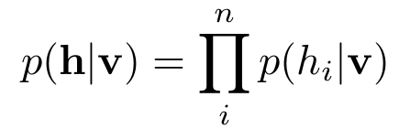
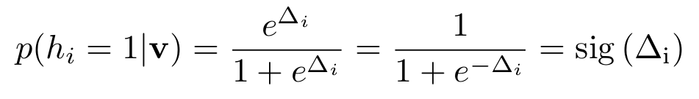
Finding expression for p(h| v)
Due to the structure of RBMs the conditional probability p(h| v) can be found analytically
Let’s group E by h_{i}
Finally we have
From this we can compute conditional probability
Probability of activation of i-th hidden unit given visible units v

Slide 14
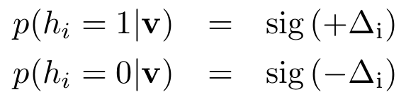
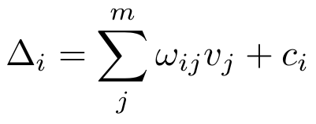
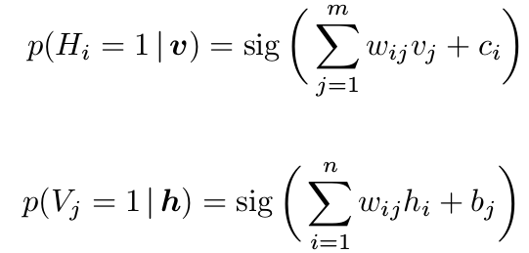
Finding expression for p(h| v)
Due to the structure of RBMs the conditional probability p(h| v) can be found analytically
Conclusions:
RBM works as stochastic neuron with sigmoid activation function
Each hidden unit is independent (restriction in hidden-hidden connections)
Similarly for visible units

Slide 15
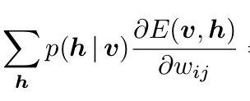
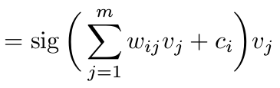
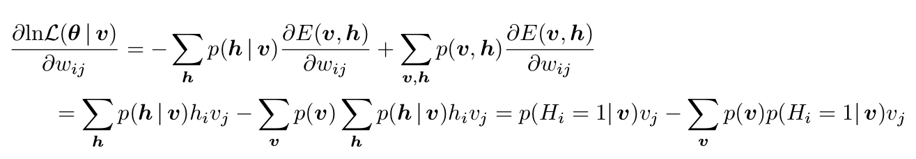
The gradient of L
The gradient can be computed using similar factorization method
After few steps of calculations we finally obtain
The final expression for the gradient of log-likelihood is given:
This is still intractable

Slide 16
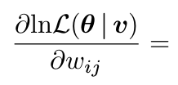
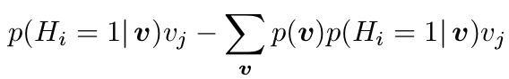
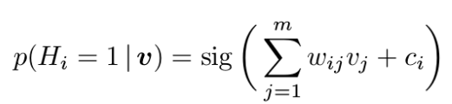
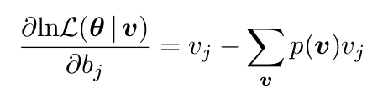
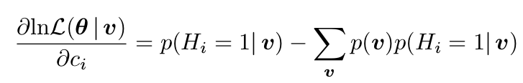




The gradient of L (per one example)
Minibatch - what is at equilibrium?
Final expressions:
probability of firing rate of the neuron
marginal probability
probability of v generated by model
For mini-batch algorithm one computes
Equilibrium condition: consider l = infinity, and gradient zero
for large mini-batch model and data distributions should be the same

Slide 17


Approximating gradients by sampling
The gradient with respect to b vector
expectation value of v
over the model probability
We do not know nice and compact form of p(v) :(
Let’s us recall simple example of sampling from gaussian distribution rho(x)
This integral can be approximated by average of sampled x from rho distribution
x is sampled from rho(x)

Slide 18





A toy example of sampling approach
Consider following example:
Approximation by sampling x from rho
In the example above we have sampled x from rho, however in real world examples we don’t know exact rho or we cannot easily sample from rho
;(

Slide 19

Approximating gradients by sampling
The gradient with respect to b vector
Let’s come back to the RBMs case:
N is a number of samples generated by p(v)
We want to approximate expectation value with sampling.
The only question which left is:
How to sample from complex distribution p(v)?

Slide 20
Markov chain Monte Carlo method (MCMCM)
We want to approximate:
This can be done via sampling method
Some definitions:
Markov chain is a time discrete stochastic process, where the next state of the system depends only on current state of the system
Many more: irreducible, aperiodic, detailed balance condition…. to define when we can use MCMC methods (stationary solution)
memoryless process
next state
current state
Markov chain can be generated with Metropolis sampling however this has some drawbacks: states can be rejected :(
Solution? Gibbs sampling method - no rejections!

Slide 21


Gibbs sampling method for RBMs
We want to approximate:
This can be done via Gibbs sampling method:
if the target distribution is p(x) we must have analytical expressions for conditional probabilities: p(x_{i}| x_{j}) for j<>i
Done!
Done!
we must be able to sample from those probabilities e.g if p(h=1|v) = 0.9 > rand() => h=1 else h=0
The algorithm:
after some steps v^{k} is a sample from p(v) distribution.

Slide 22






Gibbs sampling method for RBMs
Gibbs sampling
We want to approximate:
Let’s back to RBM we can compute p(v) using exact approach
p_v_exact:
Let’s sample p(v) with Gibbs method
WOW!

Slide 23


Gibbs sampling method for RBMs
Gibbs sampling
We want to approximate:
Gibbs sampling allows us to sample
How many samples k should we compute to estimate gradients properly?
What people do?
They use k = 1
Relative error of gradient computation using Gibbs sampling and exact

Slide 24

Contrastive divergence
Gibbs sampling

Slide 25

Contrastive divergence
This seems to work quite well but for small values of k one has to be aware of bad approximation of gradients - gradient is biased (see more in refs).

Slide 26
Persistent contrastive divergence (PCD)
don’t re-initialize v⁽⁰⁾ for each example in mini-batch

Slide 27


Dependence on k
k=20
k=2
k=1

Slide 28
Summary
RBM is an energy based model
We want to maximize log likelihood of p(v)
Using gradient ascent and CD approximation method

Slide 29


Applications of RBMs
RBMs can be used to pretrain weights for supervised learning
RBMs are generative model, one can solve in-painting problem with them
keep selected units fixed and sample rest using Gibbs sampling
Train Deep Belief networks
RBMs were used for recommendations :)

Slide 30










Notes: Why don’t we work with Energy?
RBM is an energy based model, why not minimize energy E(v) instead of p(v)
Smaller energy => higher probability
This is not true in general for E(v)
Energy is not bounded, probability must be normalize
Results for converged 3x3 BAS dataset
Energy

Slide 31
Conclusions
Don’t use RBMs if you don’t have to

Slide 32
References
https://theclevermachine.wordpress.com/page/3/ -mcmc
https://theclevermachine.wordpress.com/page/2/ gibbs sampling
http://deeplearning.net/tutorial/rbm.html - theano tutorial on RBMs (full implementation)
Training RBMs: An introduction - the best description on how do the RBMs work

